Slide 1
Notes:
Has been around since 2014, in its 7th year
Open to college sophomores from all majors, not agriculture specific, but learning about ag will be an emphasis in the program
Up to eight Emerging Leaders will be selected from eleven colleges across the US, including our University

Slide 2
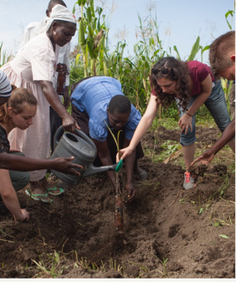
APPLY NOW FOR THE GLOBAL FOOD CHALLENGE INTERNSHIP
Open to students with an expected graduation date of May 2023 or December 2023
This Land O’Lakes summer internship program combines boots-on-the-ground learning, mentorship, and travel.
Learn more and apply by October 19th at http://bit.ly/GFCApply
Notes:
Students will submit a one minute video as a part of the online application process
You’ll spend summer of 2021 at Land O’Lakes headquarters in Arden Hills, MN with touchpoints throughout the school year
Internship includes a group consulting project, trips to local coops, Africa and the Minnesota State Legislature
Visit https://careers.landolakesinc.com/us/en/global-food-challenge or http://bit.ly/GFCApply to learn more

